Slide 1


Slide 2



AI-BASED PREDICTIVE HEALTHCARE SYSTEM
AND APPOI
Second Year Project Synopsis
Submitted by
NAME | ROLL NO.
Gaurav Bhatt | 2301010482
Industry Mentor: Dr. A K VERMA
Faculty Mentor: Dr. Tanu Gupta
Notes:
New Courses replaced with New Programmes

Slide 3

Collaboration with Verma Hospital
We are proud to collaborate with Verma Hospital under the leadership of Dr. A. K. Verma.
This partnership brings our AI-powered solutions to a real-world setting, improving patient care.

Slide 4
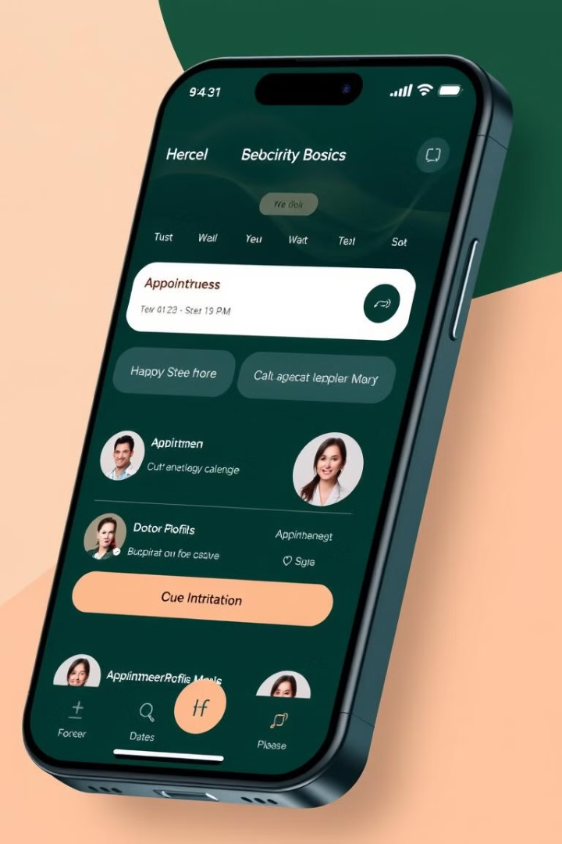
Seamless Doctor Appointment Scheduling
Easy Scheduling
Optimized Availability
Our AI-powered scheduling system makes booking appointments simple.
The system considers doctor availability and patient preferences.
Time-Saving
Patients can schedule appointments quickly and easily.

Slide 5
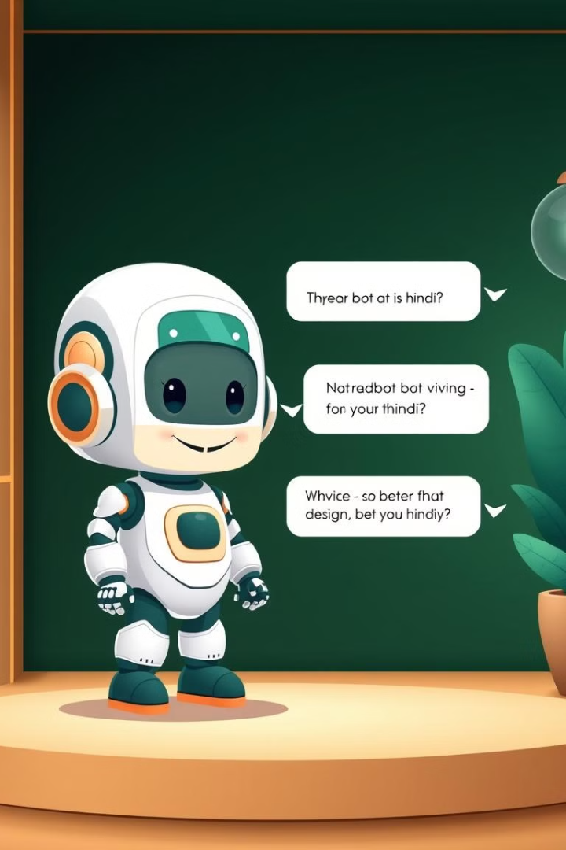



Introducing the Hindi Language Chatbot
Language Support
24/7 Assistance
Our chatbot provides Hindi language support for a more inclusive experience.
Patients can ask questions, get information, and schedule appointments.
Enhanced Access
The chatbot removes language barriers and improves accessibility.

Slide 6
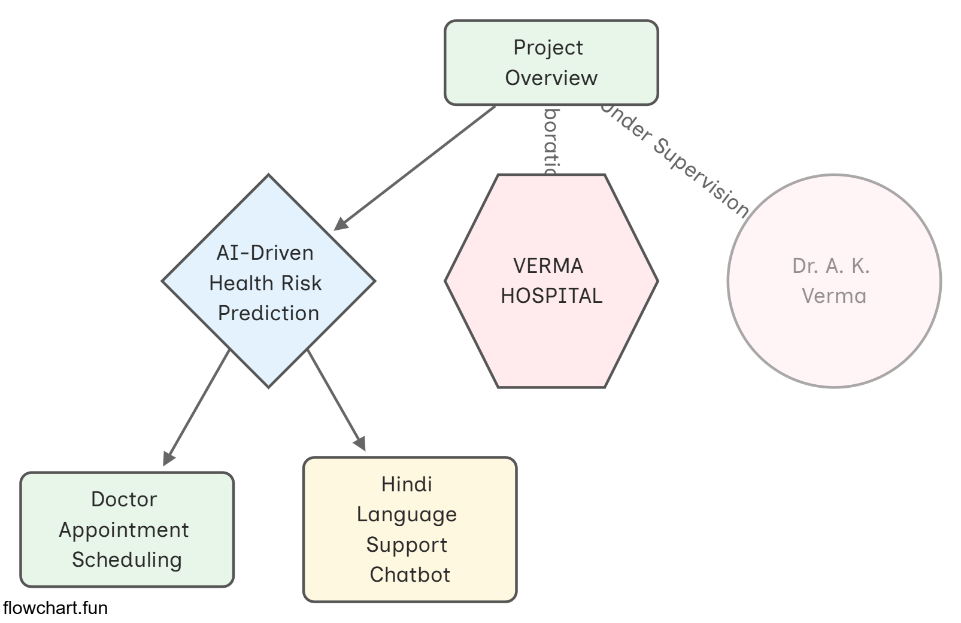
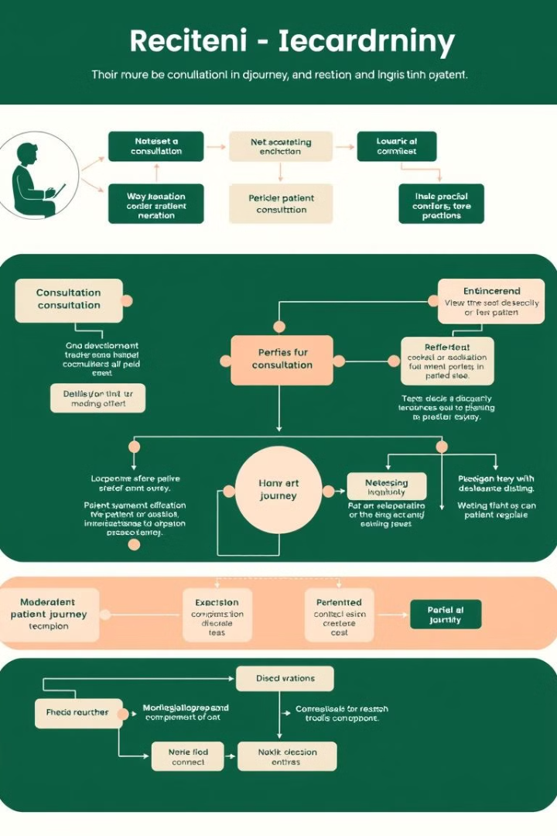
Streamlining the Patient Journey
1
Patients can easily access healthcare services through our AI-powered platform.
2
The platform connects patients with doctors, schedules appointments, and provides support.
3
Patients experience a seamless and efficient journey through the healthcare system.

Slide 7
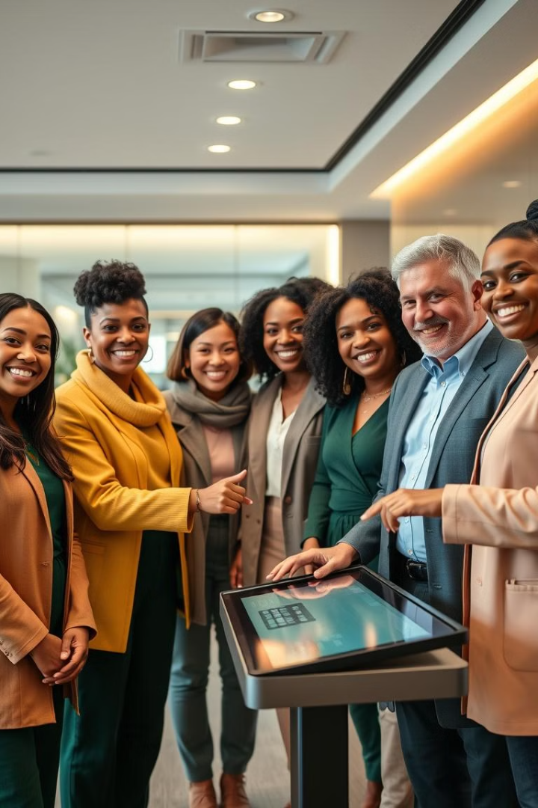
Improving Accessibility and Inclusivity
Language Support
Easy Navigation
The Hindi chatbot ensures that all patients can access information.
The platform is designed to be user-friendly and accessible for everyone.
Personalized Care
AI helps provide tailored care to meet individual needs.

Slide 8
Real-world Relevance and Impact
Verma Hospital
1
Our technology is actively used at Verma Hospital, improving patient care.
Patient Satisfaction
2
The platform has received positive feedback from patients and doctors.
Improved Efficiency
3
The AI system streamlines processes and reduces wait times.

Slide 9



METHODOLOGY
1
Python , tkinter [GUI]
2
Google Map api , SQL for management
3
Tensor Flow , github [AI MODEL ] [HINDI CHATBOT]

Slide 10
MILESTONE
1
Prototype and basic gui design is done
APP Development
2
Integration of AI and ML , and connecting multiple hospital
3
Depolying and finalizing
further working on HINDI LANGUAGE CHATBOT

Slide 11
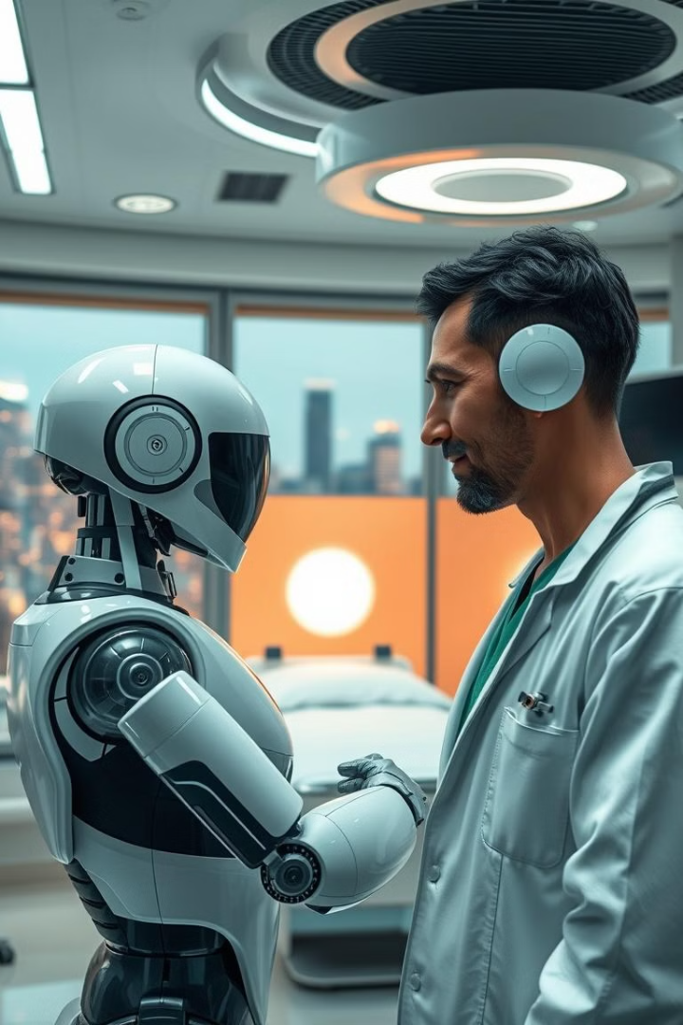
Conclusion: The Future of AI in Healthcare
1
2
AI Innovation
Accessible Healthcare
The future of healthcare is driven by AI and personalized care.
AI makes healthcare more accessible and inclusive for all.
3
Enhanced Outcomes
AI improves health outcomes and empowers patients to take control.

